Slide 1
Asian Economics
New Zealand in 2014
Firing on all cylinders
February 2014
Paul Bloxham
Chief Economist (Australia and New Zealand)
HSBC Bank Australia Limited
+61 (2) 9255 2635 paulbloxham@hsbc.com.au
View HSBC Global Research at: http://www.research.hsbc.com
Issuer of report: HSBC Bank Australia Limited
Disclosures and Disclaimer This report must be read with the disclosures and the analyst certifications in the Disclosure appendix, and with the Disclaimer, which forms part of it

Slide 2
New Zealand in 2014: Firing on all cylinders
1) China is slowing but is still set to outperform the rest of the world
2) New Zealand is at the beginning of a boom and is set to outperform in 2014
3) Post-earthquake reconstruction is massive and is ramping up
4) New Zealand’s housing market is booming and is supporting consumer spending
5) Strong Asian demand has provided a significant boost to export prices
6) NZD is likely to stay structurally high and rates may have to increase soon

Slide 3
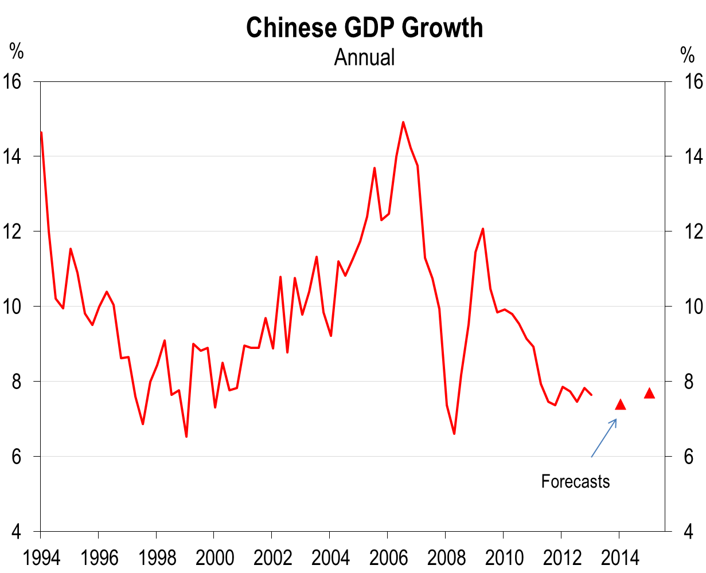
1.1) China’s GDP growth slowing to more sustainable rates, but still rapid
Source: Thomson Reuters Datastream, HSBC estimates

Slide 4
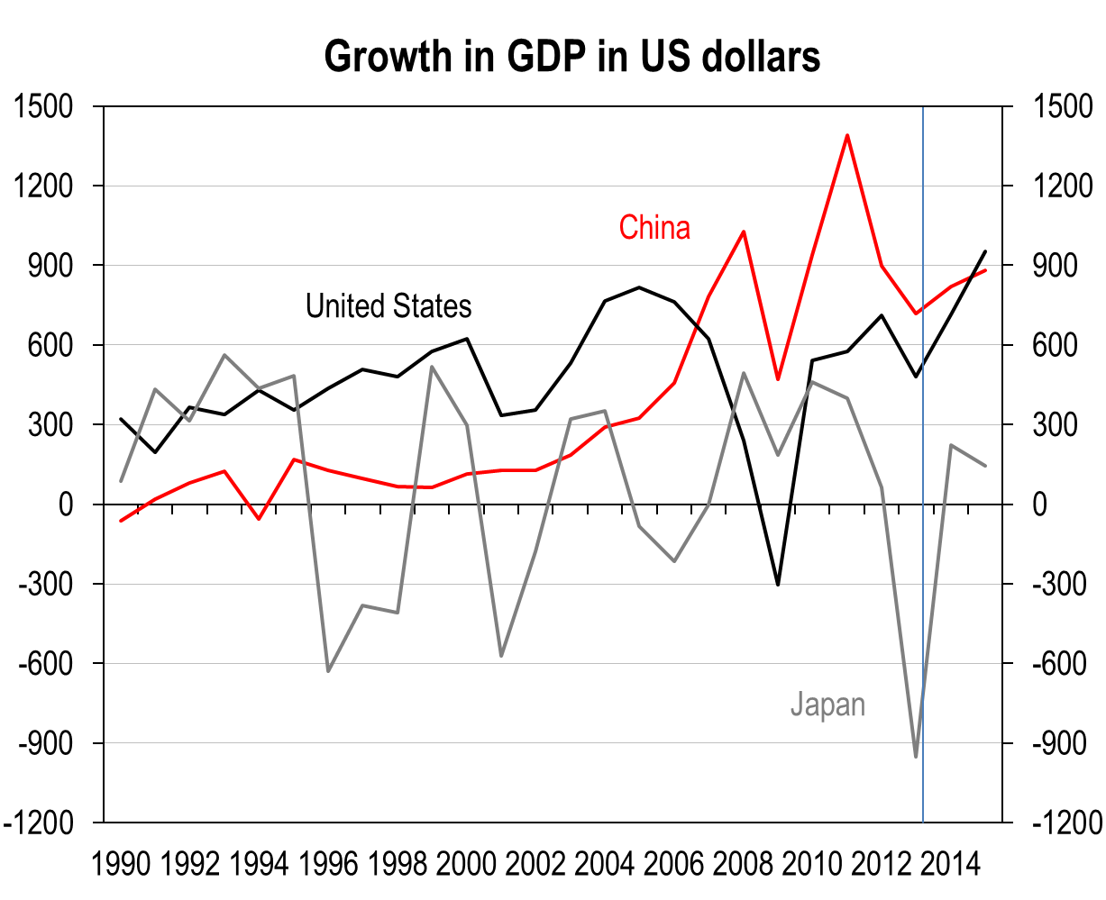
1.2) Despite slower growth, China will still contribute significantly to global growth
Source: IMF

Slide 5
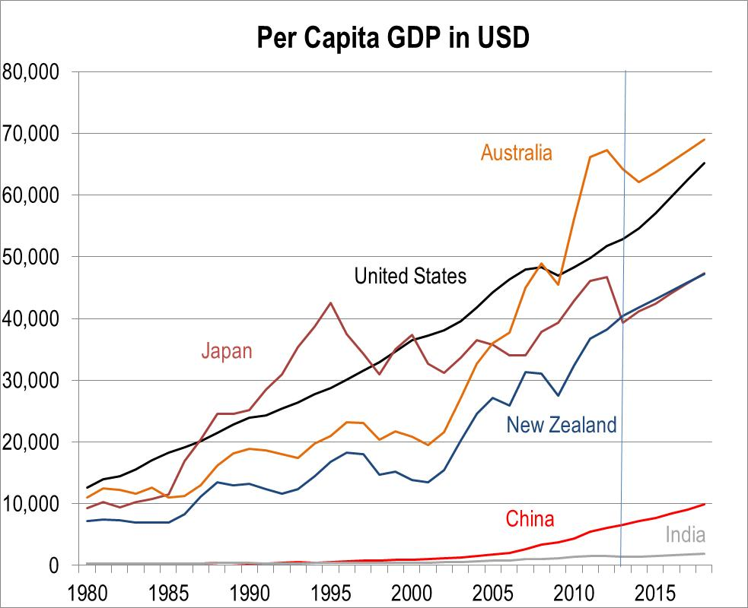
1.3) China (and India) still have a long way to go
Source: IMF

Slide 6
1.4) China is just mid-way through its urbanisation process
Source: US Census Bureau, CEIC, HSBC
6

Slide 7
1.5) Lots of growth from China yet, as large parts remain relatively undeveloped
Source: CEIC, HSBC
7
Notes:
7

Slide 8
1.6) Summary of Global Themes for 2014
- China: The year of reform – quality, not quantity of growth
- Japan: Still transforming – offshore flows expected
- United States: A modest road to recovery
- Asia: Rates matter more than exports – politics also important
- India: Stabilising, but still weak
- Europe: Better, but not good enough
- Brazil: World Cup will not be enough
- Global: Deflation is the hidden threat – watch for impact of Federal Reserve withdrawal

Slide 9
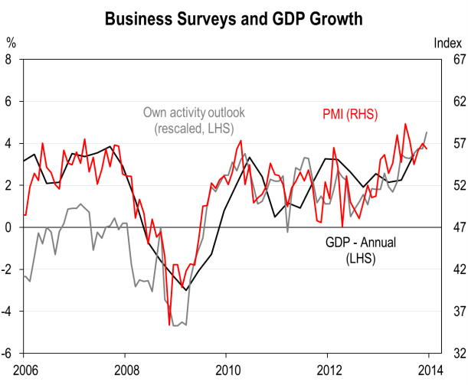
2.1) The New Zealand economy looks to be expanding at a rapid pace
Source: CEIC, Bloomberg, Statistics New Zealand

Slide 10
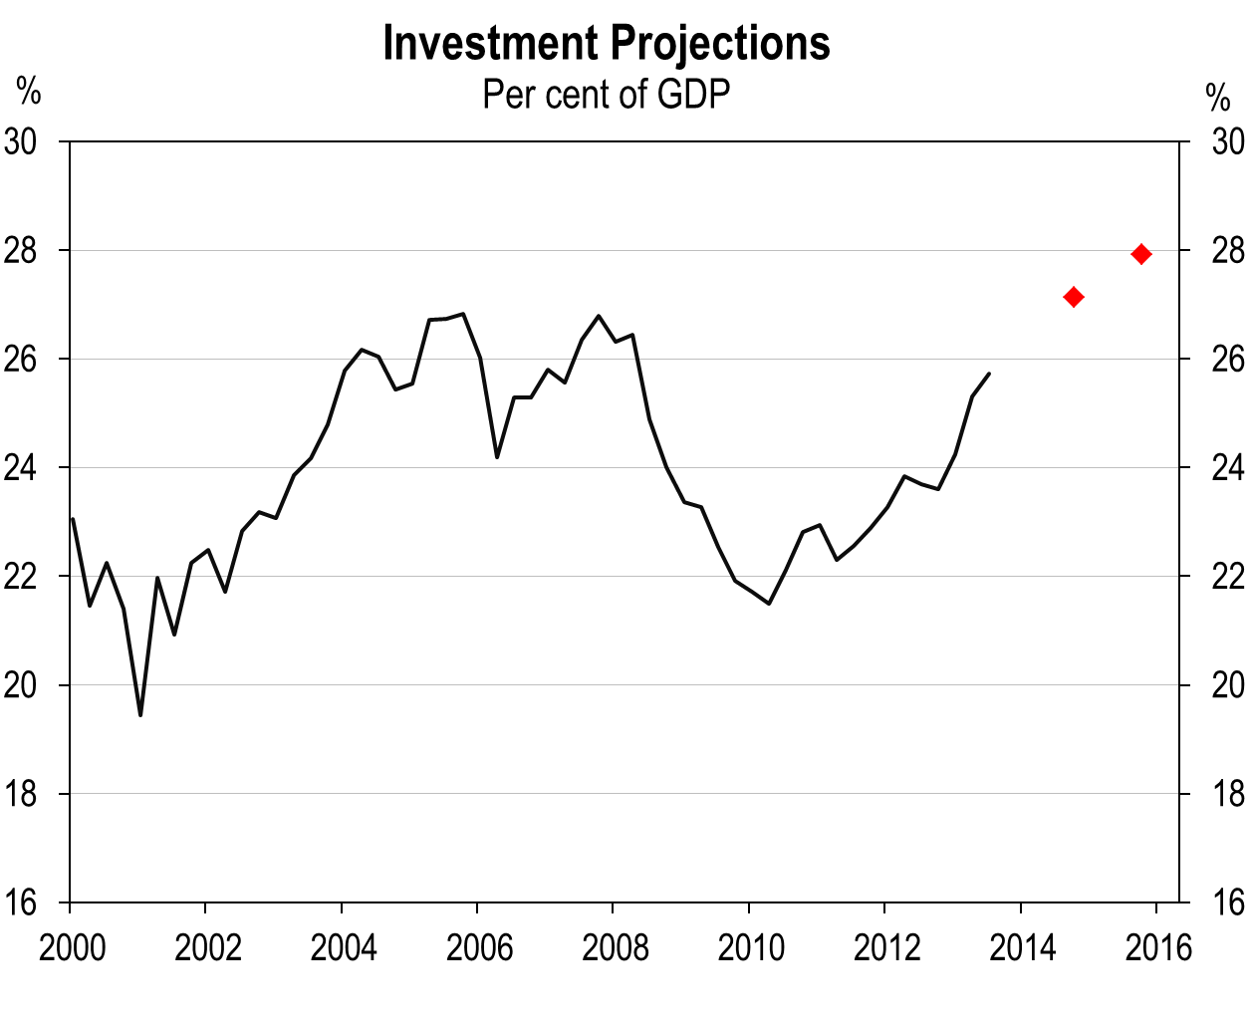
3.1) The Canterbury rebuild is large and set to persist
Source: Statistics New Zealand, HSBC estimates

Slide 11
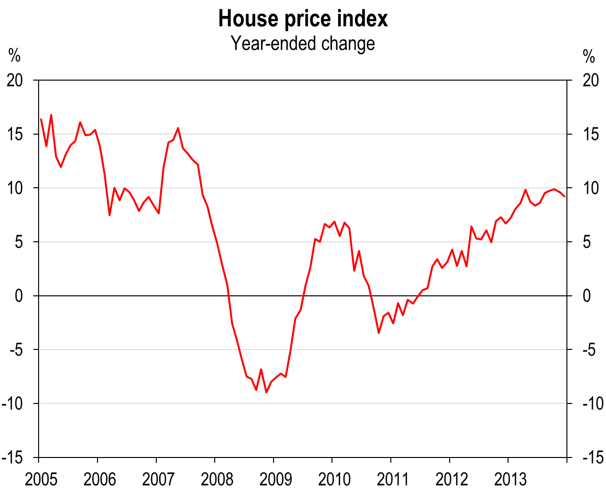
4.1) New Zealand’s housing market continues to strengthen
Source: Bloomberg

Slide 12
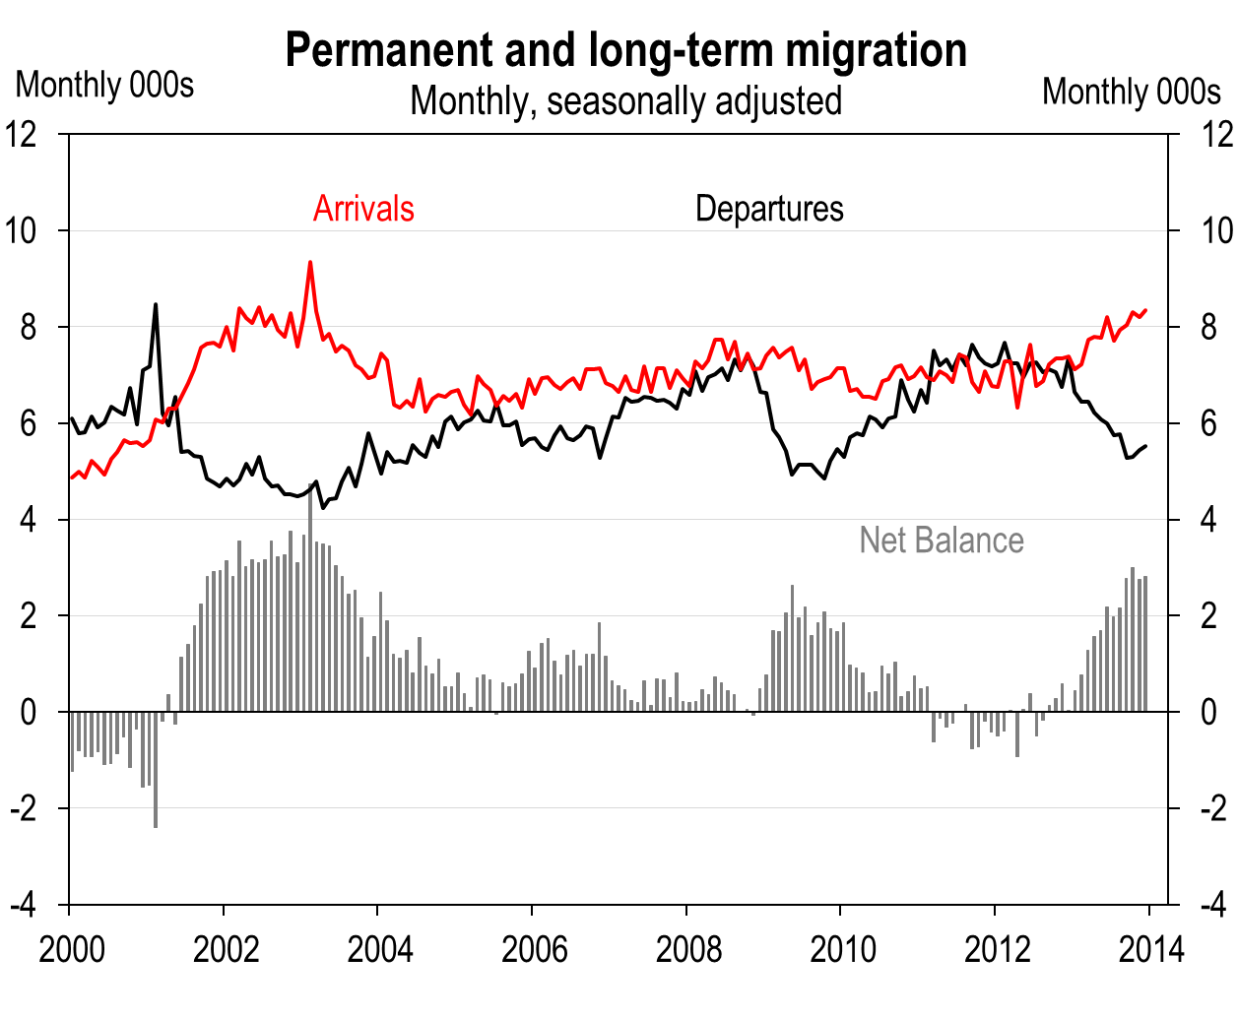
4.2) Strong inward migration is supporting housing demand
Source: Statistics New Zealand

Slide 13
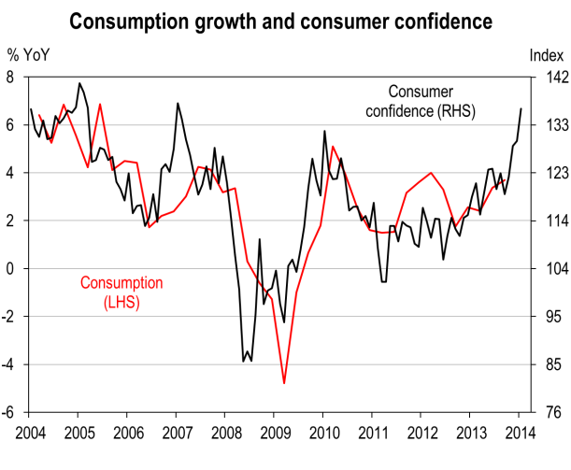
4.3) Rising asset prices and an improving labour market are supporting spending
Source: Bloomberg, Statistics New Zealand

Slide 14
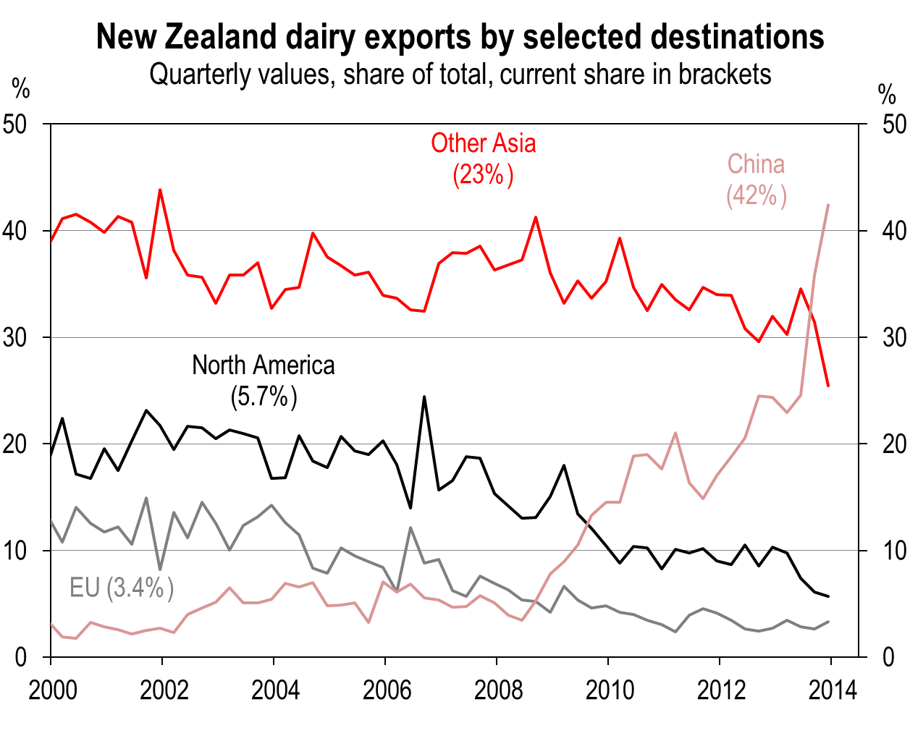
5.1) New Zealand’s primary exports are skewed increasingly toward Asia
Source: Statistics New Zealand

Slide 15
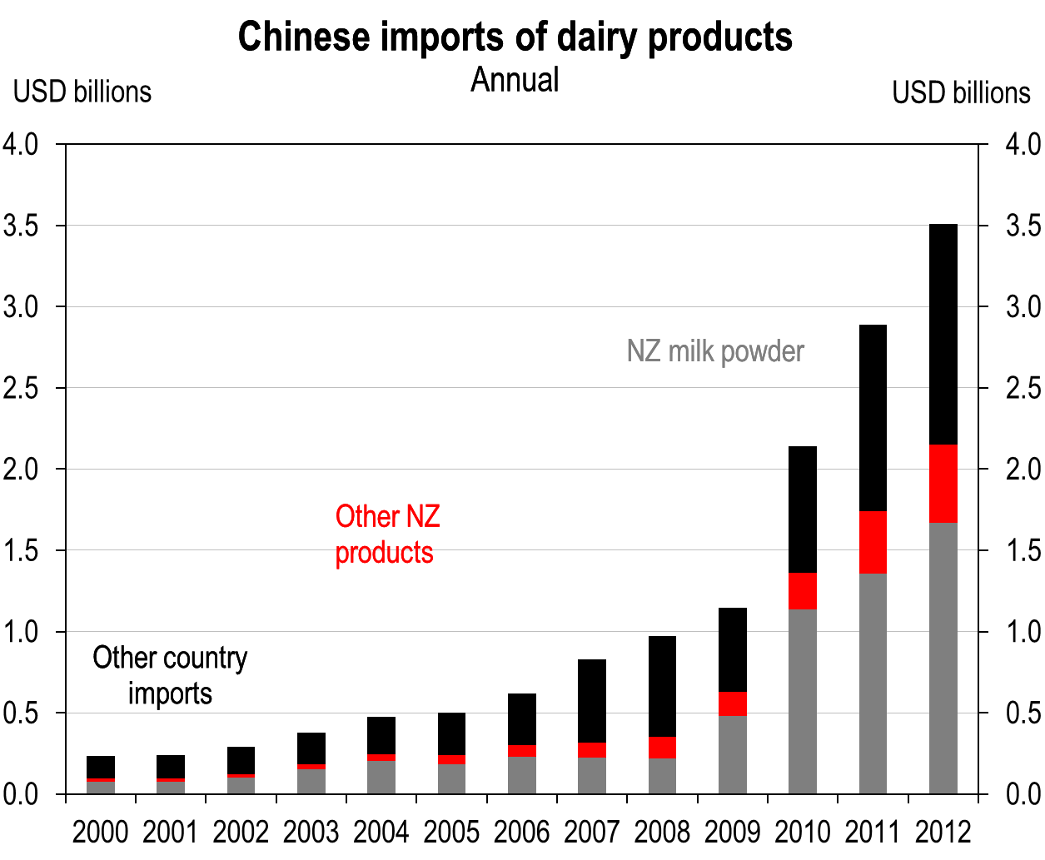
5.2) New Zealand accounts for two-thirds of China’s dairy imports
Source: UN

Slide 16
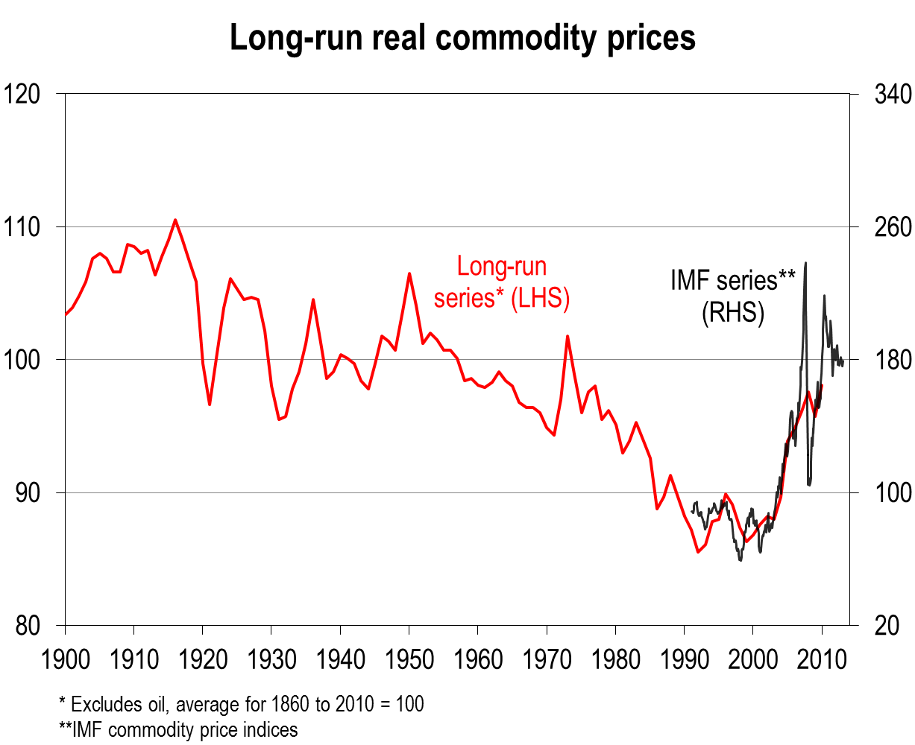
5.3) Commodity prices remain around their long run average levels
Source: United Nations

Slide 17
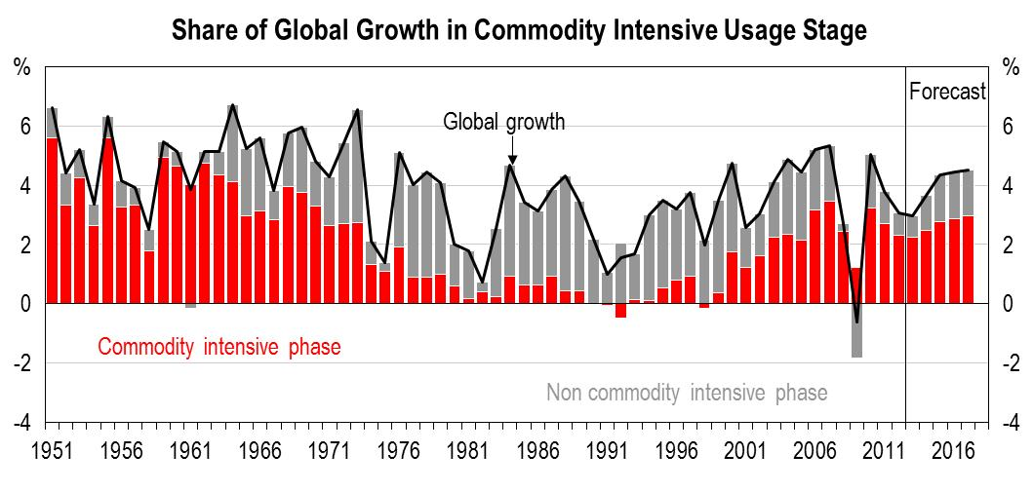
5.4) Commodity-intensive economies driving the bulk of global growth
Source: Total Economy Database, IMF, HSBC estimates

Slide 18
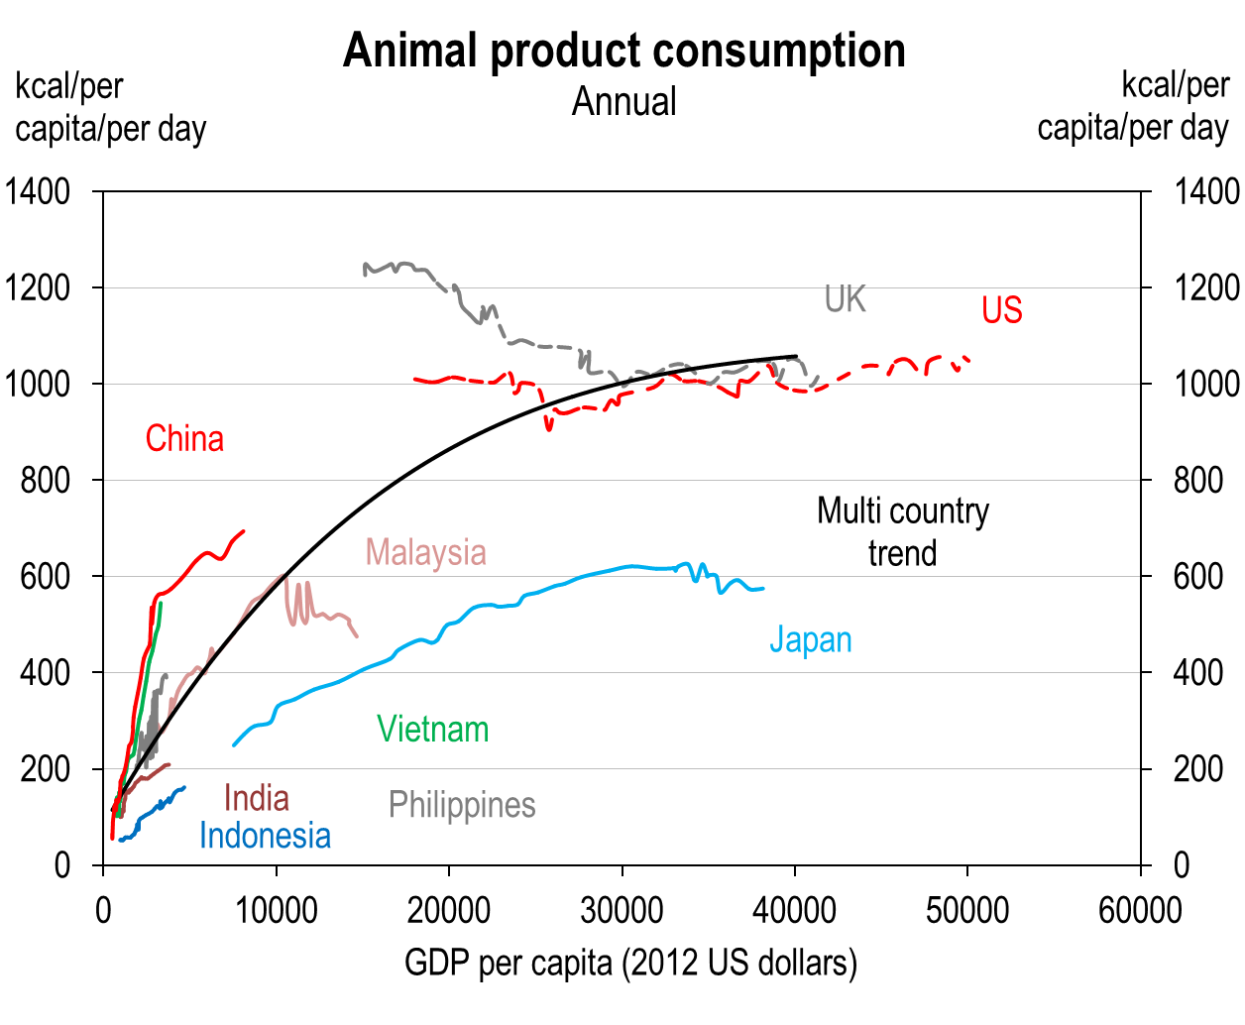
5.5) Emerging Asia’s demand for animal products likely to continue to rise
Source: FAO, Conference Board, HSBC

Slide 19
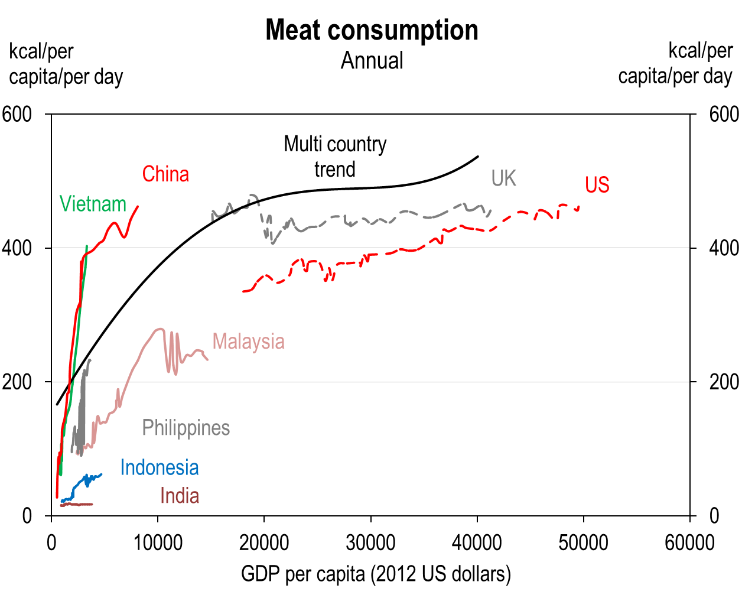
5.6) Meat consumption is already high in China, driven by pork
Source: FAO, Conference Board, HSBC

Slide 20
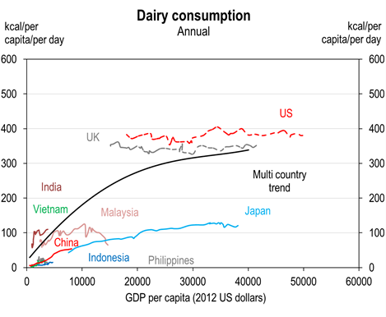
5.7) Dairy consumption is low in China and elsewhere in Asia
Source: FAO, Conference Board, HSBC

Slide 21
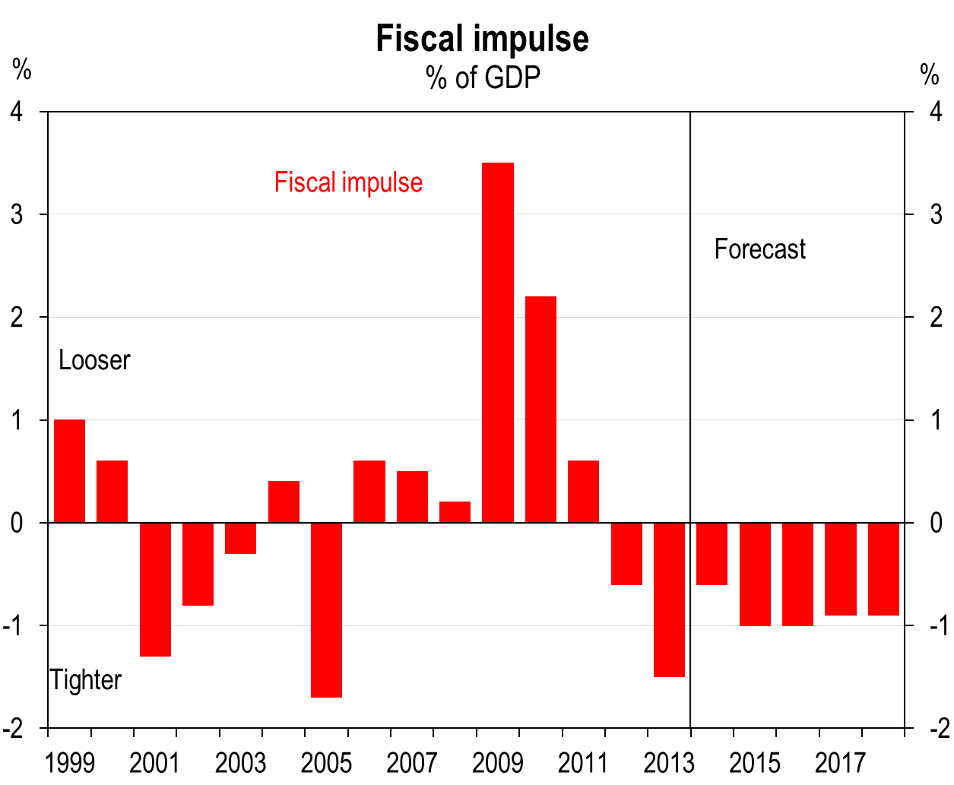
6.1) Fiscal consolidation to be a key headwind for the economy
Source: New Zealand Treasury

Slide 22
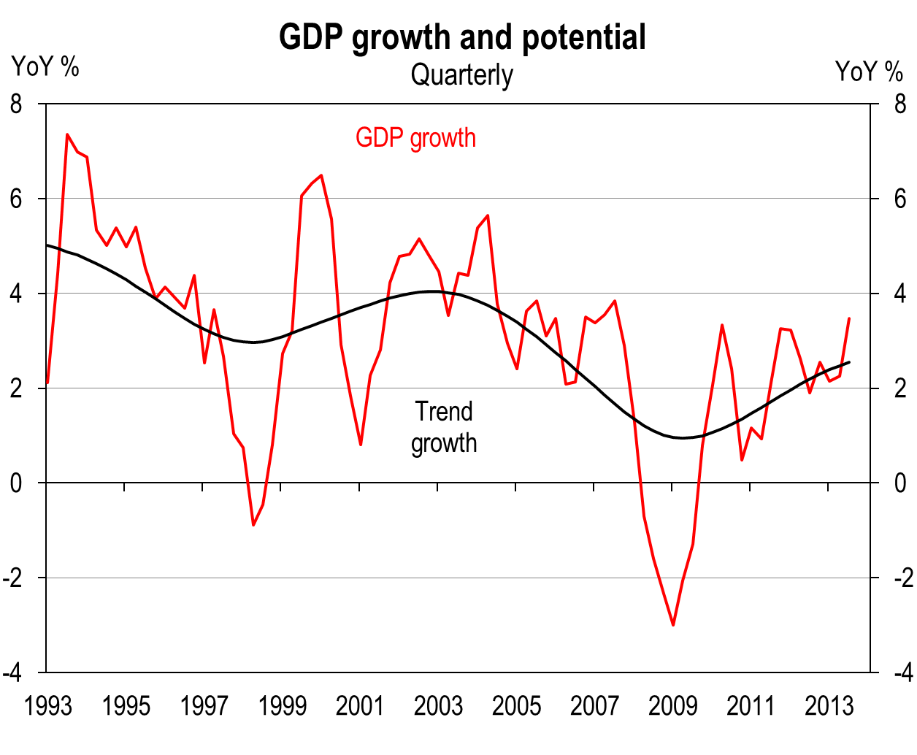
6.2) New Zealand’s supply potential has dropped since the GFC
Source: Statistics New Zealand

Slide 23
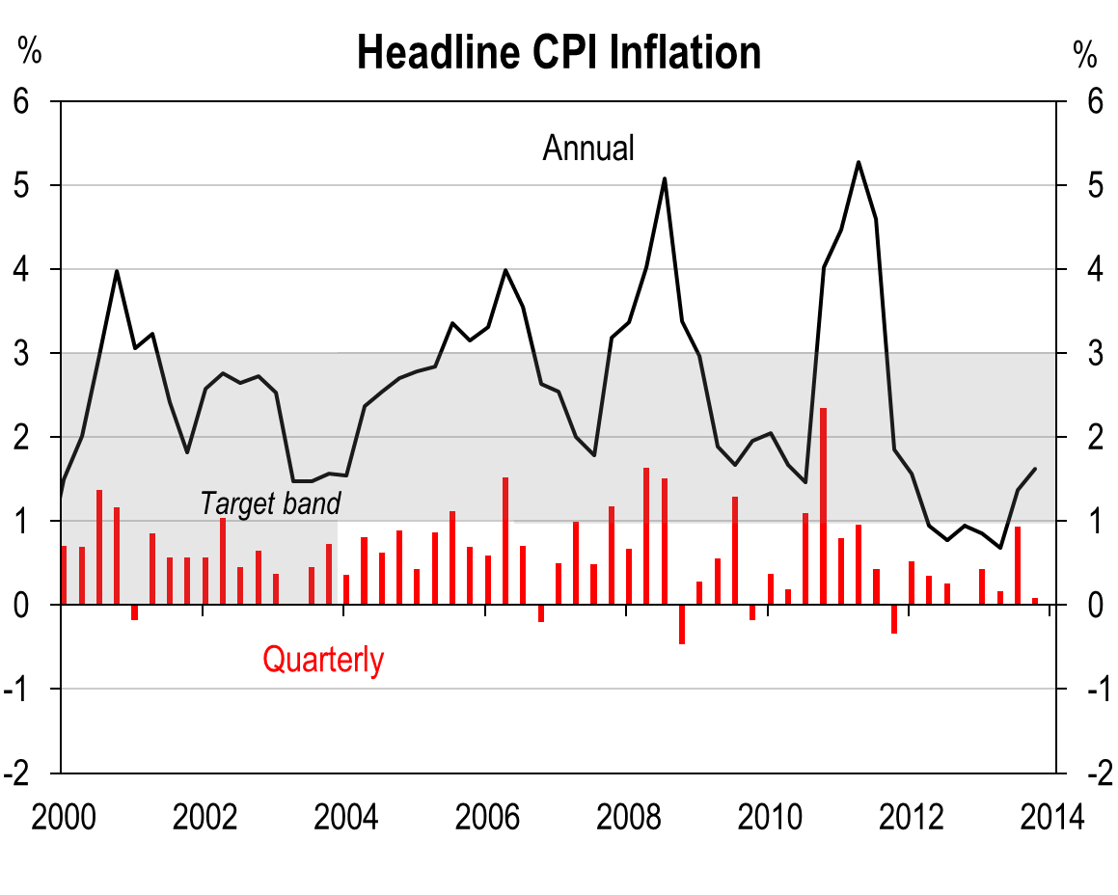
6.3) With the economy at capacity, cost pressures are beginning to rise
Source: Statistics New Zealand

Slide 24
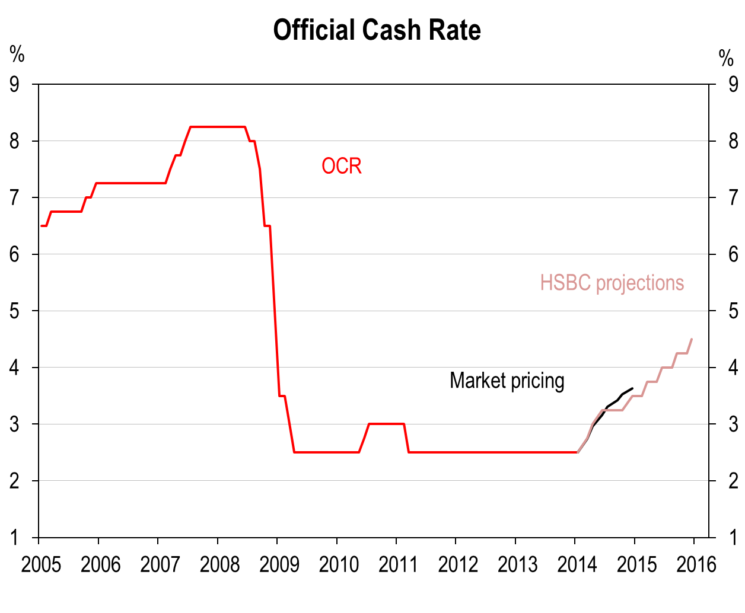
6.4) The RBNZ will need to lift rates through 2014 to keep inflation in check
Source: RBNZ, HSBC

Slide 25
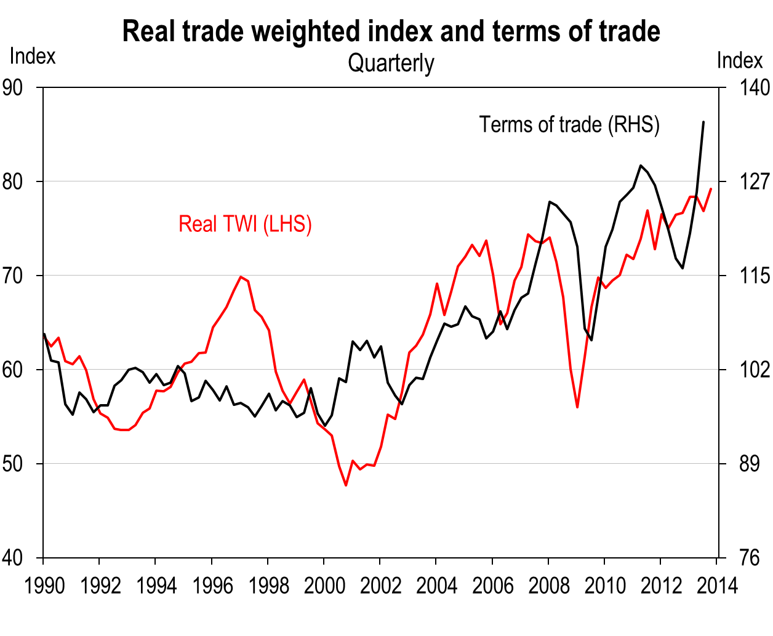
6.5) New Zealand will likely face the challenge of a strong exchange rate
Source: RBNZ, Statistics New Zealand

Slide 26
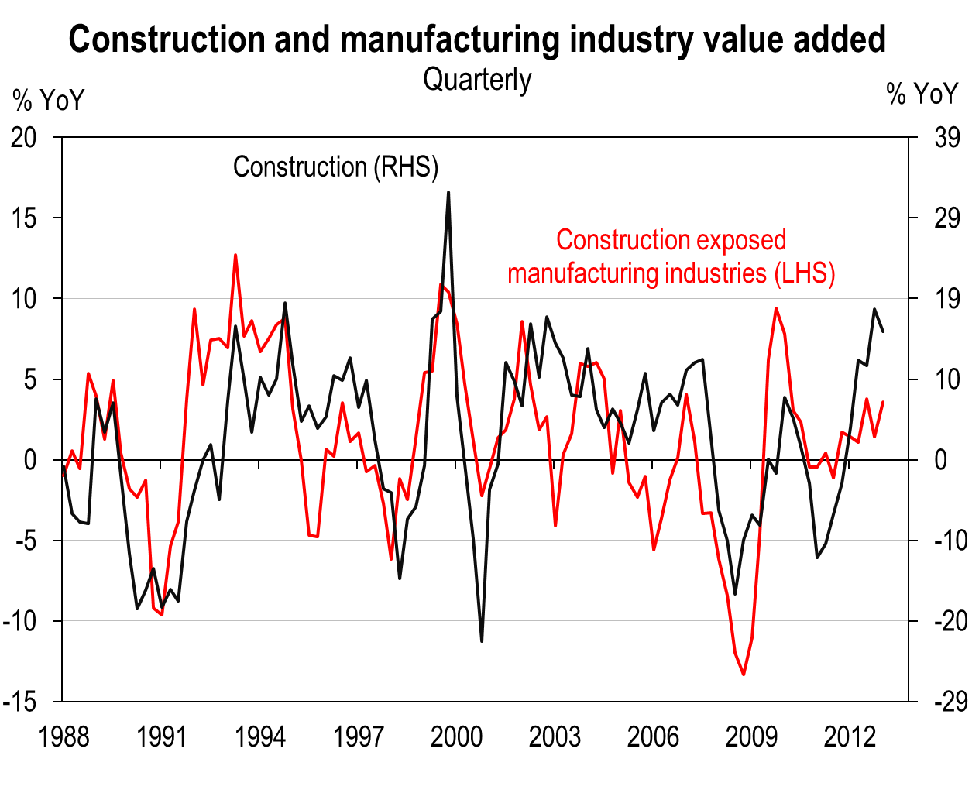
6.6) Even manufacturers are doing well, supported by the Canterbury rebuild
Source: Statistics New Zealand

